Slide 1
Planning methods of detecting anomaly from sensors
Using Variational AutoEncoders for predictive maintenance

Slide 2
|introduction
In this report I am regrouping ideas capable of tackling the problem of anomaly in predictive maintenance
This is based on the research I will be conducting as well as focusing on the aspects of VAE model which I will be using to perform the work
The aim is to set up a way to help detect the anomalies in a predictive maintenance background

Slide 3
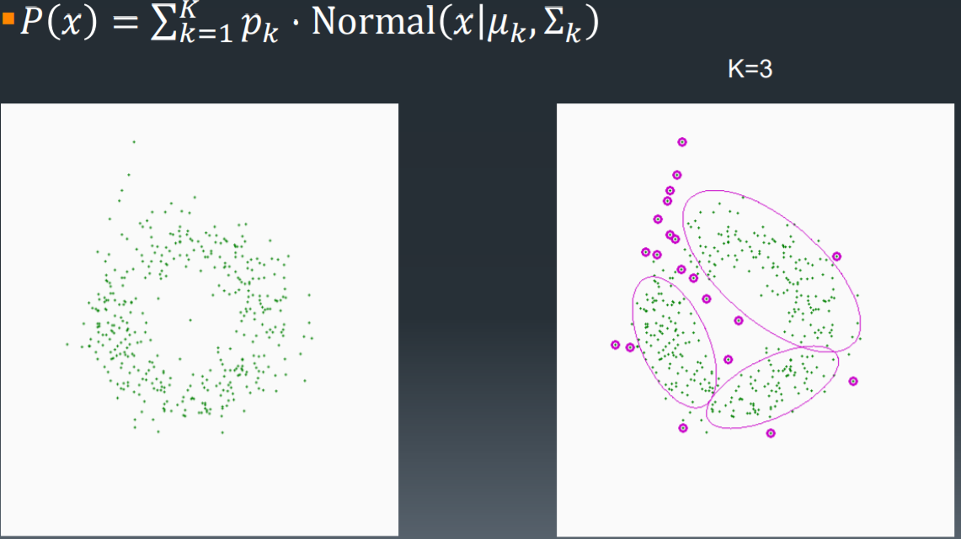
|clustering using Gaussian Mixture of latent space
Train the model to learn a lower dimensional probabilistic representation for regular functioning using VAE then the output error can help detect anomalies
In the outcome, the latent space is clustered and a likelihood is calculated for each new sample with the use of Gaussian mixture model
New time windows are streamed to the detector and anomalies are flagged below a threshold. If the anomaly rate grows too high it is then relatively straightforward to flag the equipment for maintenance.

Slide 4
|classification using reconstruction error
The reconstruction error is defined based on the evidence lower bound (ELBO). The reconstruction error (in 1D_VAE script) is the negative log probability of x (input) given z (latent space).
The sum of this error and the KL divergence is what is minimized in training of the variational autoencoder.

Slide 5
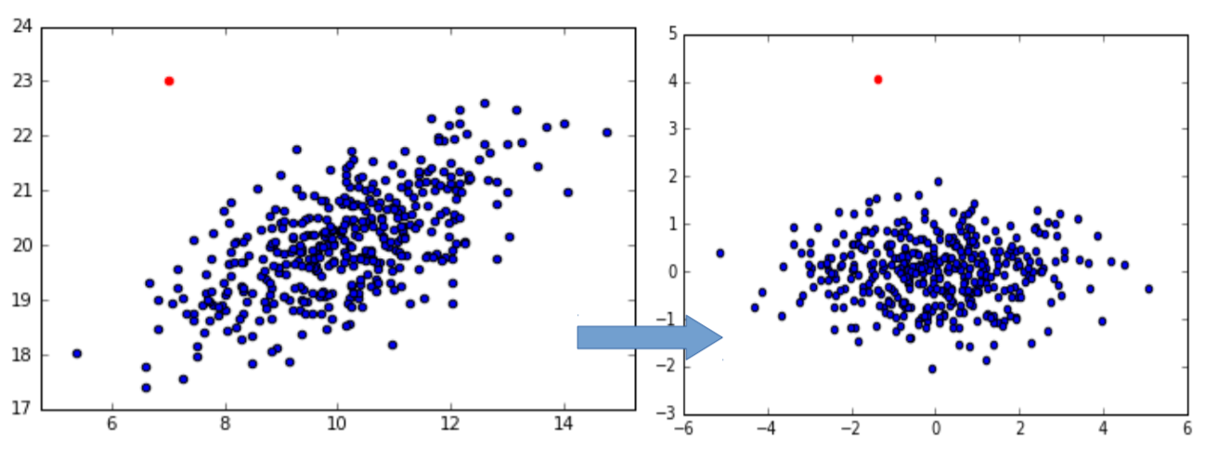
|essential steps in project
Test the model created on potential data and tuning it along the way so it can be fit to our case
Getting random samples from data to perform the training can be beneficial in understanding the usual behavior
Using the generating part of vae is also useful so we can learn to recreate the data and then look for the outliers in recreation
As an important metric, F1 can be useful to use for measuring the performance of our model
Defining thresholds an analyzing can give us also a good insight of the limits that can be called outliers
Implement PCA for a good visualization of the latent space and then compare between train and validation sets then we can learn the structure

Slide 6
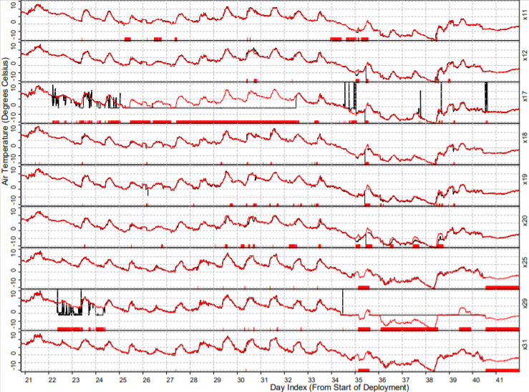
|concept
In manufacturing, specially looping and automatic systems that requires consistent supervision and most cases use sensors for that aim but most of the time.
Understanding equipment failure in that sector we have to comprehend anomaly data requires a lot of money and time since it is usually rare and hard to detect
A consistent approach is then needed to have a systematic tracking of these unusual behavior and can save a lot of resources. That gets us to understand the following concept

Slide 7
|concept
Detection of outlier events or observations: Detecting deviations from the expected pattern of a data set.
The real challenge in anomaly detection is to construct the right data model to separate outliers from noise and normal data.
In our case we are going to focus on the unsupervised learning approach where we will tend to find structure in data
Important techniques consist of the use of PCA, Gaussian mixed models and Autoencoders
Research has shown that variational autoencoders (VAE), a type of neural network, can work for detecting anomalies from images. We can adapt this idea to work on 1D time-series sensor data.

Slide 8
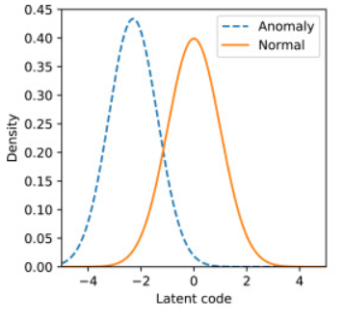
| Variational AutoEncoders
VAEs generalize more easily than normal autoencoders because it works on probabilities. We can use different types of RNN-VAE architectures to recognize the outliers of time series data
A generative model can learn a probability distribution model by being trained on an anomaly-free dataset. Afterwards, outliers can be detected by their deviation from the probability mode
normal data prior distribution is a Gaussian distribution close to N(0,I), and the anomalous prior is another Gaussian distribution, whose mean and variance are unknown and different from the normal prior

Slide 9
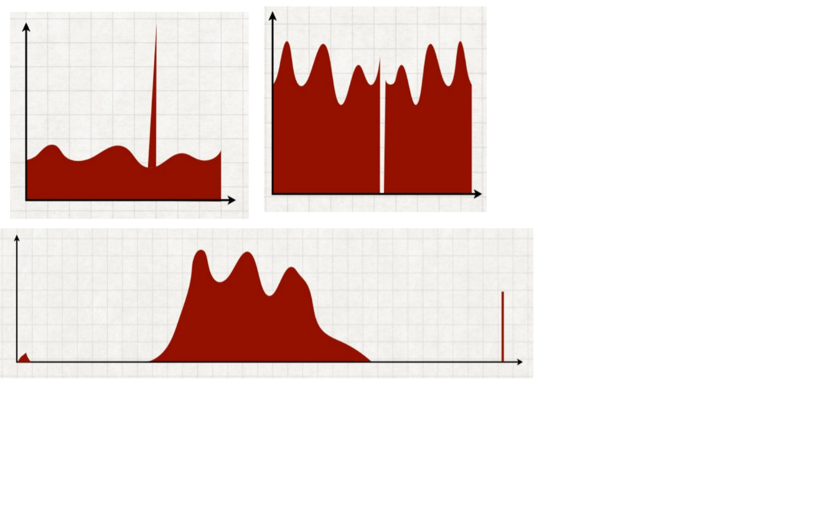
| Anomaly Detection ?
Input:
vectors 𝒙 ∈ R for i=1,…,N
Assumed to be a mix of “normal” and “anomalous” data points ▪
Anomalies are generated by some distinct process (e.g., instrument failures, fraud, intruders, etc.)
Output :
Anomaly score Si for each input Xi that higher scores are more anomalous and similar scores imply similar levels of anomalousness
Metrics
AUC: Probability that a randomly-chosen anomaly is ranked above a randomly-chosen normal point
Precision in top K

Slide 10
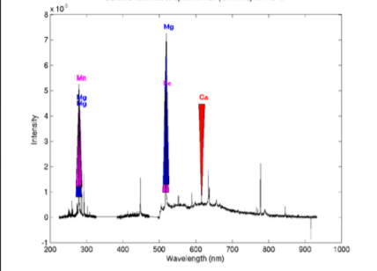
| Intuitive points
Understanding data structure and cleaning data
Finding interesting points in the waves injected to the input
Benchmarking anomaly on data sets to help have a correct detection
Point difficulty: How difficult is it to separate each individual anomaly point from the normal points?
Relative frequency: How rare are the anomalies?
Clusteredness: Are the anomalous points tightly clustered or widely scattered?
▪Irrelevant features: How many features are irrelevant?

Slide 11
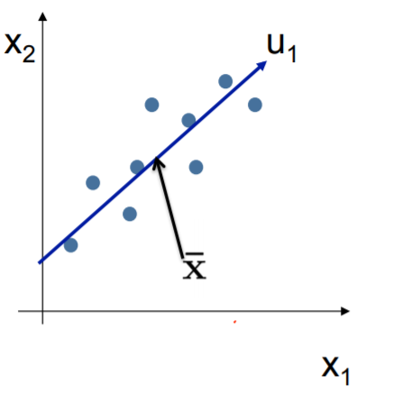
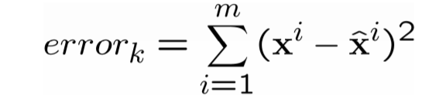
| Anomaly and PCA
PCA: finds linear boundaries, effective if the data are linearly separable in the feature space
PCA finds projection that minimizes reconstruction error
Given k<n, find (u1,…,uk)
minimizing reconstruction error

Slide 12
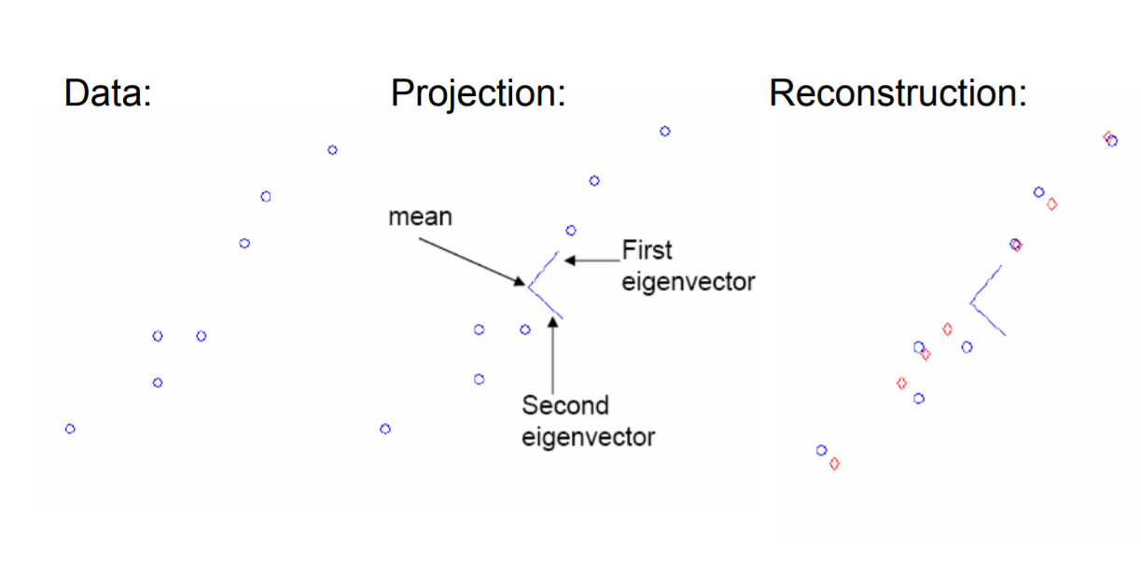
In high-dimensional problem, data usually lies near a linear subspace, as noise introduces small variability data projections must be kept only onto principal components with large eigenvalues. Some information can be lost, but if the eigenvalues are small there’s no much to lose
| Anomaly and PCA

Slide 13
| PCA with SVD
Write X,=,W,S,VT
X ←data matrix, one row per datapoint
W ← weight matrix, one row per datapoint
coordinate& of xi in eigenspace
S ←singular value matrix, diagonal matrix
• in our setting each entry is eigenvalue λj
VT ← singular vector matrix
• in our setting each row is eigenvector vj

Slide 14
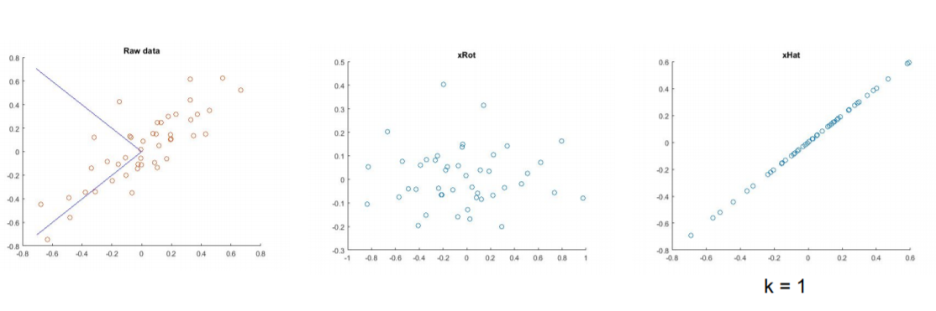
| Reconstruction from compressed representation
Algorithm :
○ Preprocess data, i.e., zero mean and scale variance if need
○ Compute the covariance matrix of normalized data
○ Compute the eigenvectors and eigenvalues of the covariance matrix
○ The first top k eigenvectors correspond to the first k principal components
○ Project the data into the k-dimensional subspace

Slide 15
PCA vs Neural Networks
PCA
Unsupervised dimensionality reduction
Linear representation that gives best squared error fit
No local minima (exact)
Non-iterative
Orthogonal vectors (“eigenfaces”)
Neural networks
Supervised dimensionality reduction
Non-linear representation that gives best squared error fit
Possible local minima (gradient descent)
Iterative
Auto-encoding NN with linear units may not yield orthogonal vectors

